Slide 1
Examining the short-term effects of sexually degrading music on self-image
Mike Powers, Jessica Vincent, Cathy Zhou
Notes:
Jessica

Slide 2
Research Question:
What impact does short-term exposure to sexually degrading music have on short-term self-image for male and female adults?
Notes:
Jessica
In 30 seconds: What is your research question? Why is an experiment necessary?
We specifically focused on music that was sexually degrading towards women
Needed to be short term based on the parameters of this assignment

Slide 3
Hypothesis.
BASIC H_{a}:
Self-image of those who do not listen to sexually degrading music
Self-image of those who do listen to sexually degrading music
DIRECTIONAL H_{a}:
Self-image of those who do not listen to sexually degrading music
Self-image of those who do listen to sexually degrading music
Sub-hypothesis:
ATE women ≠ ATE men
Notes:
Jessica
In 30 seconds: What is the specific hypothesis that you’re testing that is implied by theory or your question? What direction do you expect your outcomes to move as a consequence of treatment?
Ho: They equal each other
Ha: They do not equal other
Since we focused on music that was sexually degrading towards women, we hypothesize that the music will lower the esteem of women. We do not hypothesize the directional impact on men.

Slide 4



Experimental Design.
<18 exited
Gender
Age
Randomized to treatment groups
1.
Participant selects age and gender
Control: No music
Placebo: Neutral music
Treatment: Degrading music
2.
Qualtrics Randomizes treatment assignment
Two 30 second clips
Two 30 second clips
3.
Participant listens to music clips if assigned
Lyric Quiz (2 fill in the blank questions)
Next button only presented after length of clip
Have you heard this song?
Do you like this song?
4.
Participant completes lyrics follow up if assigned
On the whole, I am satisfied with myself.
At times I think I am no good at all.
I feel that I have a number of good qualities.
… Question 10
5.
Participant completes self-image questionnaire
Notes:
Jessica
In 60 seconds: What is your treatment? Be specific. Show pictures of it, show the language that you used, etc. For me or the class to understand what you did, we need to understand what you did!

Slide 5
Experimental Design - RXO.
Group | Assignment | Treatment | Measurement
Control No Music | R |  | O
Placebo Neutral Music | R | X_{Placebo} | O
Treatment Degrading Music | R | X | O
Notes:
Jessica
In 60 seconds: Draw out using the ROXO grammar your experiment design, describe the comparisons that you’re going to make that tell you something causal. Call this a RDD, or a D-n-D, or a within subjects or a between subjects comparison.
https://www.socialresearchmethods.net/kb/desintro.php

Slide 6
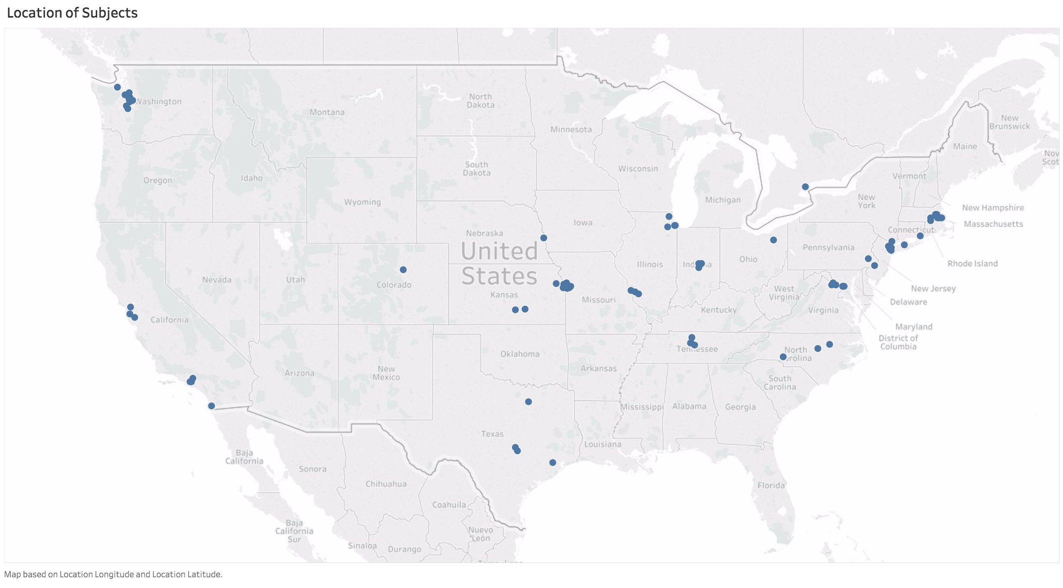



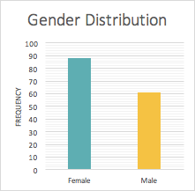
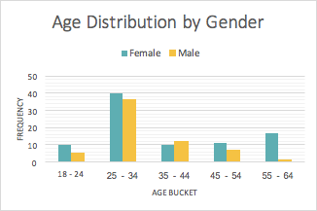
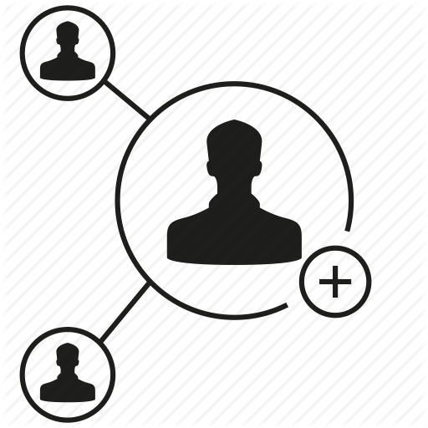
Sample Population.
We sampled our contacts:
Family
Friends
Coworkers
Social media contacts
They spanned gender, age, and geographic location.
Notes:
Mike
In 30 seconds: explain who/what your measurement units are. People? From where? Robots? What type?
Sample population: Anyone 18 +
Focused on our contacts, in order to maximize participation in a short time period without providing compensation or other incentives
Our most common age group was 25-34 years olds across gender. Of those in the oldest age bracket, the majority were female

Slide 7
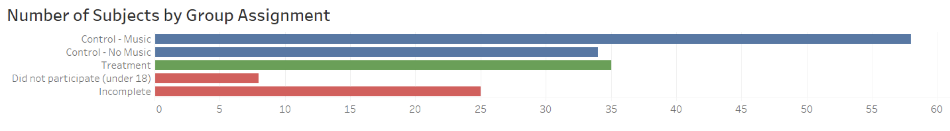
Randomization and Attrition.
Placebo Control Treatment Under 18 Incomplete
Randomization Mechanism
Used Qualtrics’ randomization tool to assign participants to treatment, placebo, and control
Would expect roughly ⅓ of participants in each of these buckets
Observed this in pilot study
Saw a much greater number of participants assigned to the placebo group than the treatment or control in our experiment
Exploration of Attrition
Uneven treatment groups caused us to view attrition in more detail
25 subjects started the experiment and did not complete it
19 stopped on the first page after age and gender
3 started the treatment song but never completed esteem questions
3 started the placebo song but never completed esteem questions
Notes:
Mike
In 30 seconds: How did you randomize and did it work?
We randomized the group subjects were assigned to using Qualtrics built in randomizer
Randomizer should have given each subject equal probability of being assigned to one of the three groups
We ended up with more subjects in the Placebo group (Group with neutral music)
Unable to determine reason
We saw attrition, but it didn’t appear to be concentrated in any of the three groups
Most of the attrition appears to happen on the first page of the experiment (we ask for age and gender)
Our thought is that people visited the experiment because they were interested to see it, but didn’t bother to finish it

Slide 8
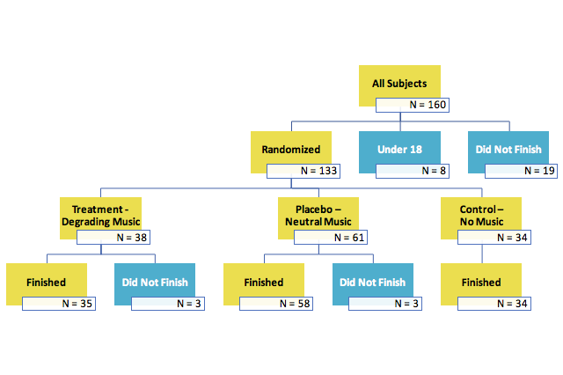
Flow Document.
Notes:
Mike
Present a flow document like in Box 13.3.
Yellow boxes indicate subjects who did not complete experiment

Slide 9
Outcome Measures
Rosenberg Self Esteem Scale
A 10-item scale that measures self-worth by measuring positive and negative feelings about the self
All items are typically answered using a 4-point Likert scale: strongly disagree, disagree, agree, strongly agree
We extended this to 7 options to give subjects a greater range of choices and a neutral option
Each subject’s final esteem score is calculated by summing each question
The final score can range from 10 to 70
Lower score = higher self esteem
On the whole, I am satisfied with myself.
At times I think I am no good at all.
I feel that I have a number of good qualities.
I am able to do things as well as most other people.
I feel I do not have much to be proud of.
I certainly feel useless at times.
I feel that I'm a person of worth, at least on an equal plane with others.
I wish I could have more respect for myself.
All in all, I am inclined to feel that I am a failure.
I feel that I'm a person of worth, at least on an equal plane with others.
Notes:
Jessica
In 60 seconds: Describe your outcome measures. What are they? How are they related to the concept that motivated this experiment? What are they distributed like?
http://fetzer.org/sites/default/files/images/stories/pdf/selfmeasures/Self_Measures_for_Self-Esteem_ROSENBERG_SELF-ESTEEM.pdf

Slide 10
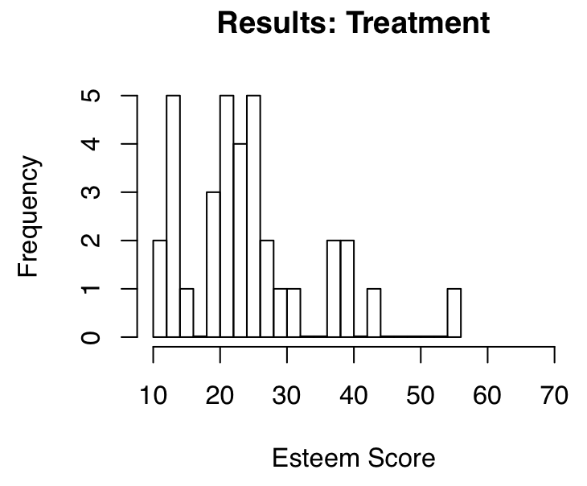
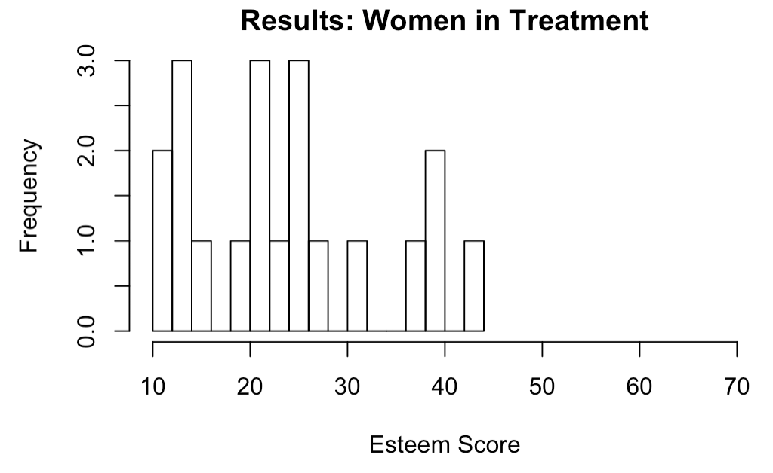
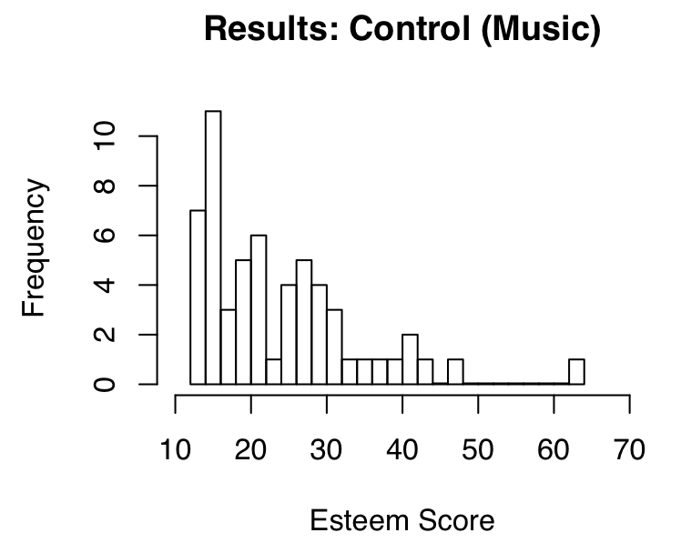
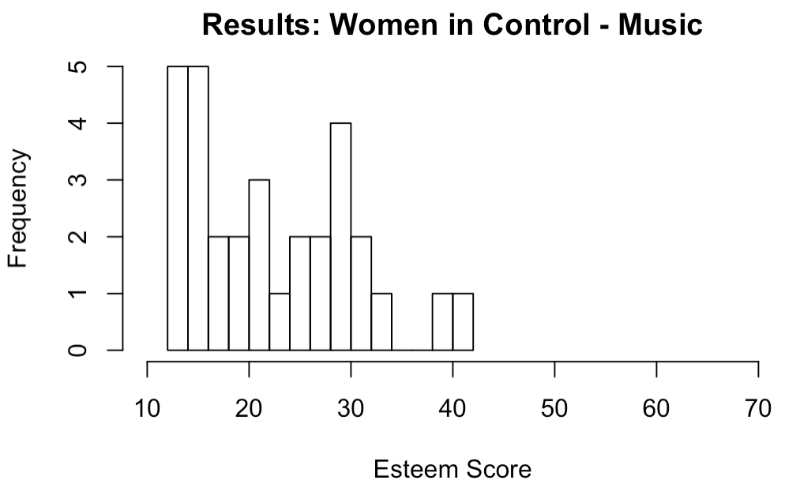
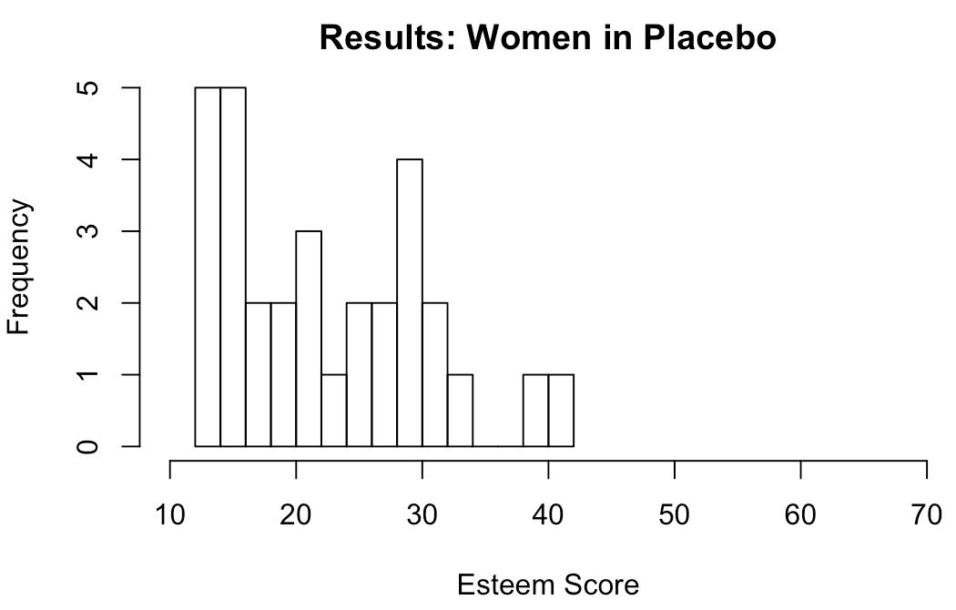
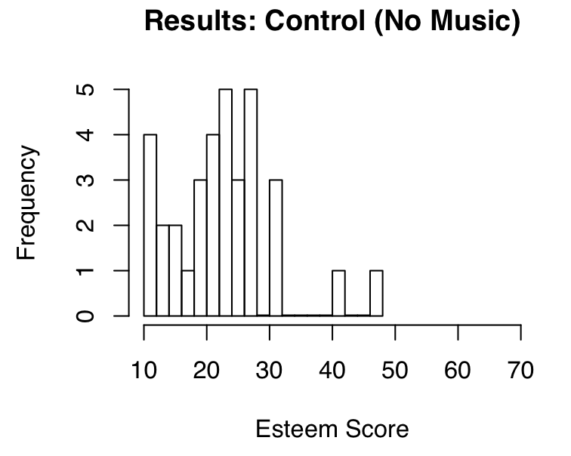
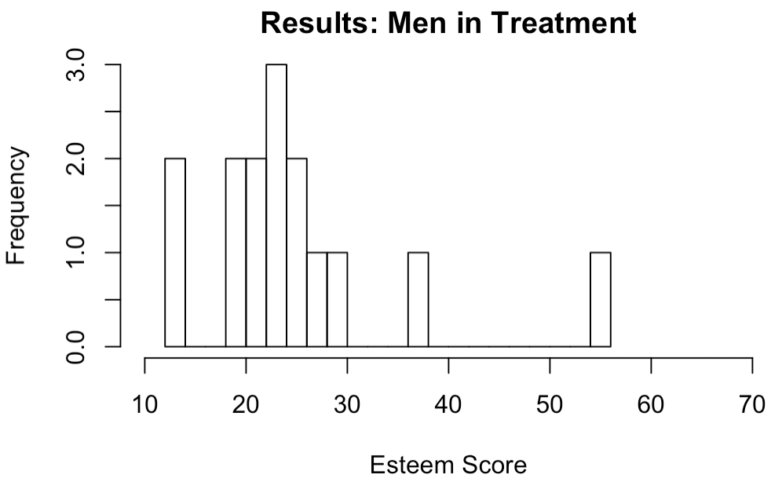
Experiment Outcomes
Aggregate
By Gender
Based on initial plots, we see that the treatment group has more of a right tail than the control, and more/higher modes than the placebo
This appears especially true for female participants
We use regression analysis with controls to see if these are significant
Placebo
Lower scores = higher esteem
Notes:
Jessica
In 30 seconds: Describe trends

Slide 11
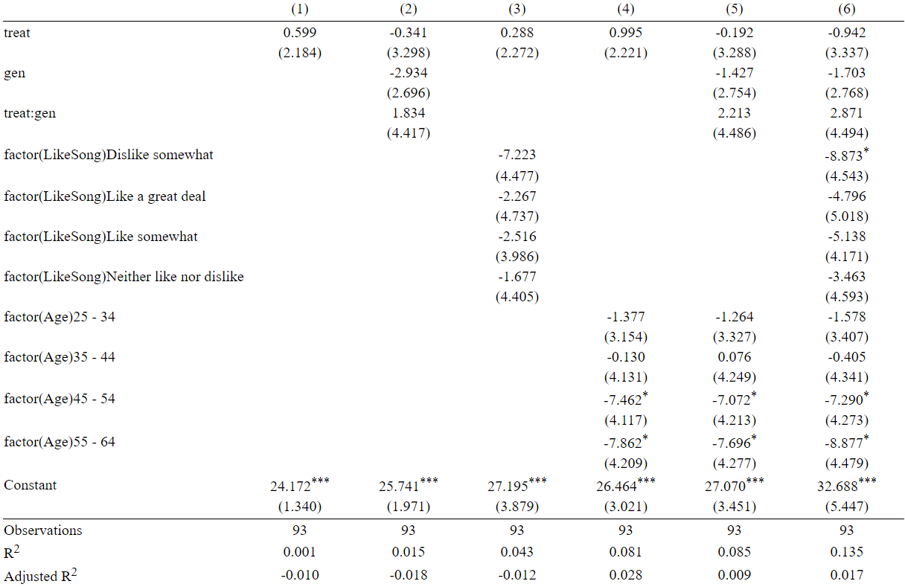
Results
Treatment
Control for gender (1 = female)
Control for enjoyment of song
Control for age
Constant
Notes:
Mike
150 seconds
Results of Treatment vs. Placebo
We did not see a statistical difference in the treatment effects in the Placebo (Neutral music) and Control group (no music).
Therefore, we decided to focus our analysis on the Treatment and Placebo group, since these groups experienced the more similar conditions, except for the treatment
None of our effects are statistically significant. However, we do see interesting patterns that matched our hypotheses.
[gen] (1 if woman) coefficient is negative which indicates that women had baseline lower score (higher esteem) than men
Interaction of [treat] and [gen] is positive, which indicates that our treatment raised scores (lowered esteem) more in women than men
We anticipated this because the treatment song was sexually degrading towards women
Older subjects had baseline lower scores (higher esteem) than younger subjects
Subjects who disliked the songs had lower scores (higher esteem) than others. We think these are the older subjects, who probably like the songs less than younger.

Slide 12
Outstanding Questions.
For those who used Qualtrics, did anyone have groups where the % of subjects in each group appeared to deviate from expectations?
19, or approximately 12%, of our subjects decided to not participate in the experiment after the first page. Does this concern anyone?
Our experiment required volunteers. Could these volunteers be associated with certain covariates that could have impacted results?
Notes:
Mike
In 30 seconds: List the questions and concerns that you want your peers to help you puzzle through.

